Slide 1
Solving Nerdle

Slide 2
Part 1: Background

Slide 3
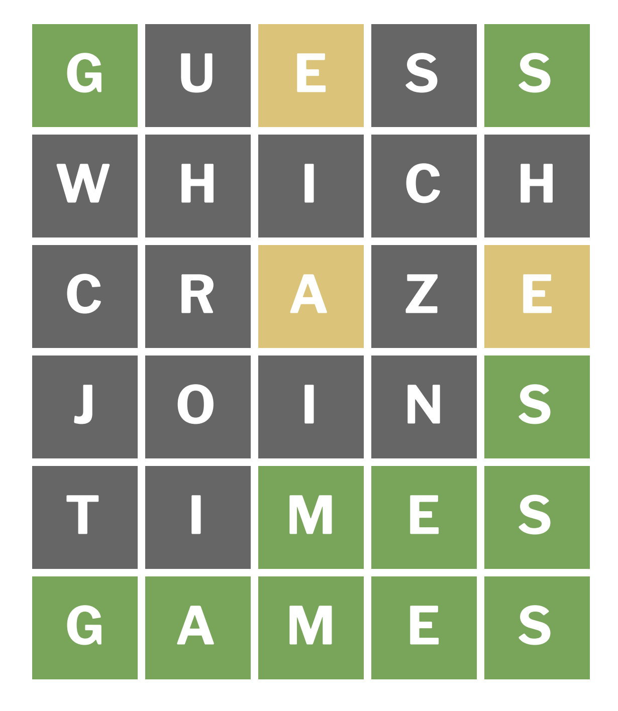
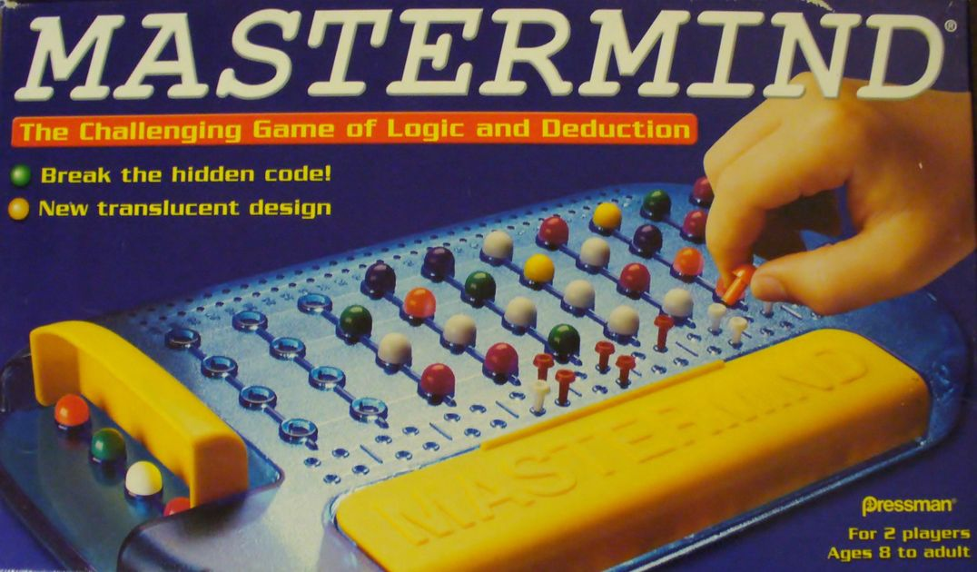
Wordle
Word-guessing game
Based on old boardgames like Mastermind

Slide 4
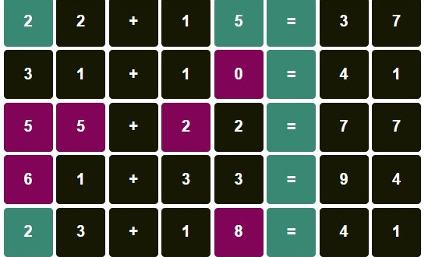
Nerdle
Equation-guessing game

Slide 5
Let’s play a game!
https://nerdlegame.com/

Slide 6
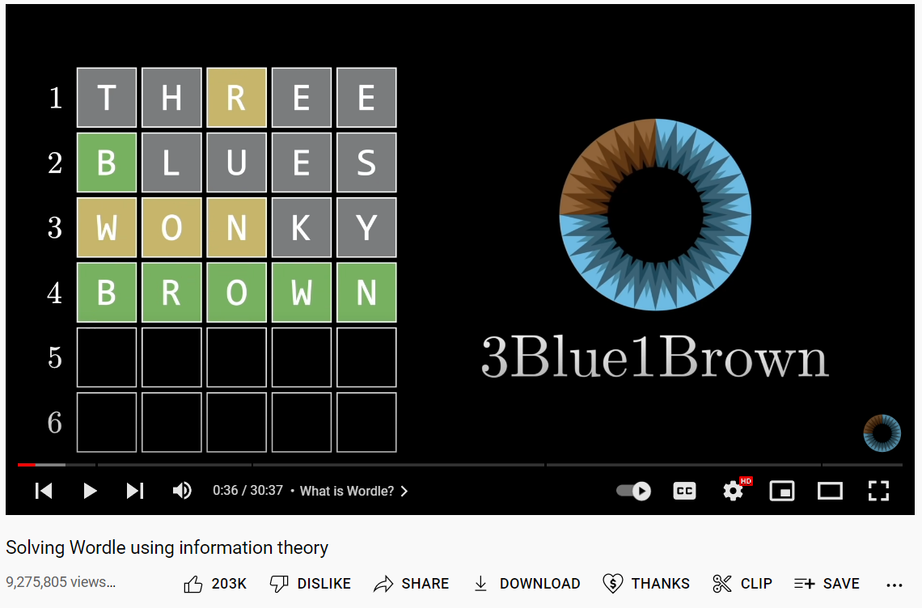
How to play these games optimally?
What is the best possible first-guess?
What is the best strategy for getting further gueses?

Slide 7
Nerdle seems harder… but why?
Nerdle uses 8 characters (number and operations) instead of 5 letters.
A word’s validity is arbitrary. An equation’s validity is not.

Slide 8
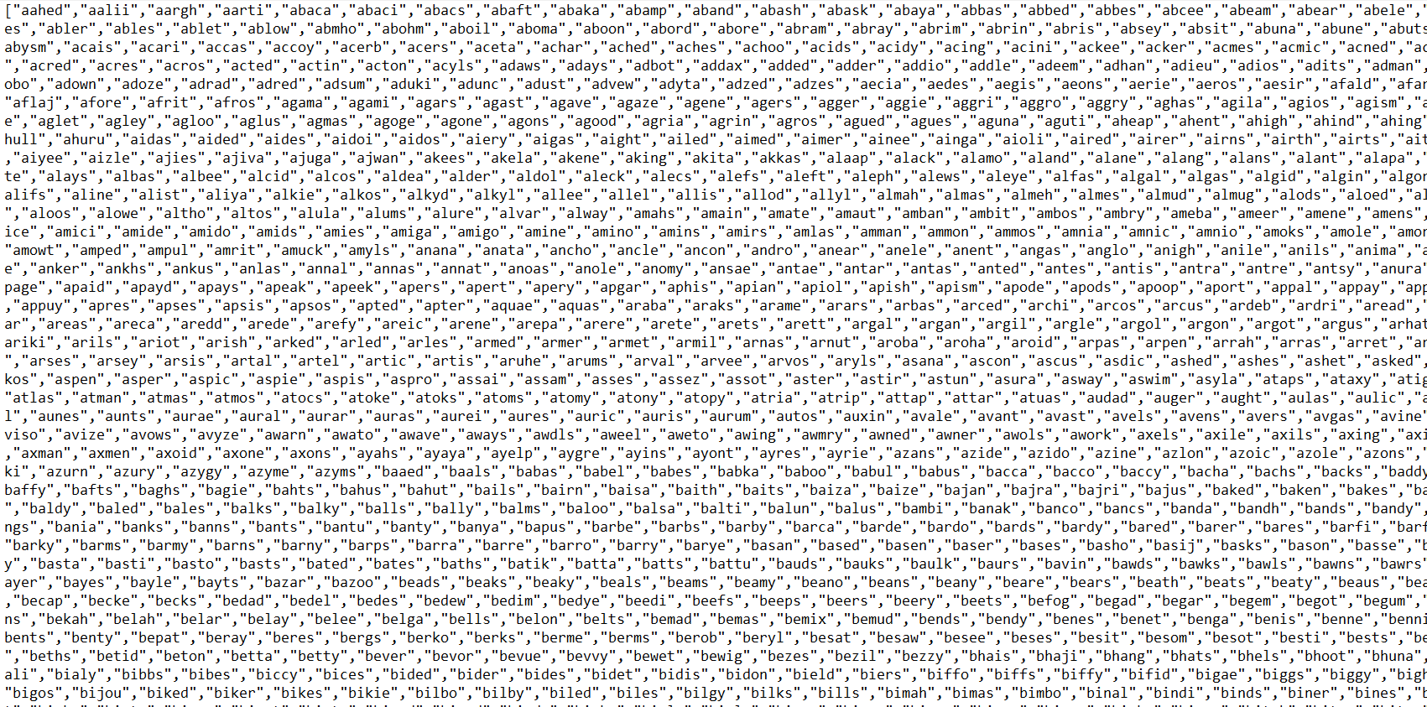
Input-Checking
Wordle checks inputs by comparing it to a list of allowed words
Nerdle checks inputs by putting them through a parser

Slide 9
Solution
Generate a list of valid Nerdle inputs.
Use that list to find the best-possible first-guess
Approach the problem in a way that can be applied to other Nerdle variants (micro, mini, etc…)

Slide 10
Part 2: Generating the Solution Space

Slide 11
Formal Languages
Given an alphabet Σ, we can form infinite strings, Σ*
Binary alphabet Σ={0,1}, Binary strings Σ*
A formal language is a set of words that are formed by a set of rules
Palindromes (Rule: same going forward/backward)
Equations (Rule: LHS equals RHS)
Regular languages are a subset of formal languages

Slide 12
Do arithmetic equations (Nerdle words) form a regular language?

Slide 13
Do arithemtic equations (Nerdle Words) form a regular language?
Yes. The solution space of Nerdle is finite and all finite languages are regular languages.
But what about the generic class of arithmetic equations?

Slide 14
“Pumpable” Languages
Given a string s that’s a part of language L, divide s into substrings xyz.
Is xz in the langauge? Is xyyz? xyyyz?
Languages that follow this property are called “pumpable”

Slide 15
Pumping Lemma
If a language L is regular → L is “pumpable”
Contrapositive:
If L is NOT pumpable → L is NOT regular

Slide 16
Proof: Arithmetic equations do NOT form a regular language
Let L be the language of all arithmetic equations.
Consider s: “1=1” belonging to L
“1==1” does NOT belong to L
We can generalize s to a string of any length.
L is not pumpable.
L is not regular

Slide 17
Maximum Size of Solution-Space…
15 characters (10 digits, 4 operators, 1 equals)
Naive estimate:
15
15
15
15
15
15
15
15
15⁸=2.56 billion guesses!

Slide 18
A Better Guess…
The number of Nerdle equations is actually upper-bounded by 387 million
85% reduction from the original number of permutations!
Notes:
The First entry: 12 guesses - 10 numbers and + -, but not * /
The Last entry: 10 guess - 10 numbers
The rest: 15 guesses - 10 numbers and + - * / =

Slide 19
Proof of the Better Guess…
An equal sign appears somewhere in the middle… (6 slots to put the =)
First slot cannot be * or / (12 options)
Last slot must be a digit (10 options)
Remaining slots can be anything (14 options)
6✕12✕10✕14⁵ = 387 million permutations
Size of solution space: 17,723 equations
Size of guess space: 562,672 equations
Notes:
The First entry: 12 guesses - 10 numbers and + -, but not * /
The Last entry: 10 guess - 10 numbers
The rest: 15 guesses - 10 numbers and + - * / =

Slide 20
Part 3: Entropy and the Best Guess

Slide 21
Entropy
Given a random variable/probability distribution, entropy is the amount of “information” we expect to get from the variable:
H(X) = -ΣP(x)ᐧlogP(x)
The more “information”, the higher the entropy…
Notes:
Mike’s slide for video

Slide 22
Finding the next Best Guess
Every guess is associated with a probability distribution (the probability that one of the color patterns will show up…)
Every distribution is associated with an entropy
Every guess is associated with an entropy value.
Picking the guess with the highest entropy value maximizes information received from that guess…
Notes:
Mike’s slide for video

Slide 23
Revealing the Best first guess…
48-36=12
Notes:
Mike’s slide for video

Slide 24
Conclusion

Slide 25
Stats for Nerds
Average computer score: 3.05
Average human score: high 3s, low 4s
100% solve rate
Maximum score: 4/6

Slide 26
Further questions
How does commutivity make things easier?
How does hard mode make things easier?

